Slide 1
BEEKEEPING DEVELOPMENT PROGRAMME
Presented by
EDGAR BOWA
0964834475/0979697048
MSc. Sustainable Land and Environmental Management-UNZA
Senior Lecturer
ZAMBIA FORESTRY COLLEGE.

Slide 2
OUTLINE
Introduction
Beekeeping requirements
Bee colony
Types of hives
Apiary establishment
Bee trees/Botany
Beekeeping Promotion Approaches
Activities & Challenges
Conclusion

Slide 3
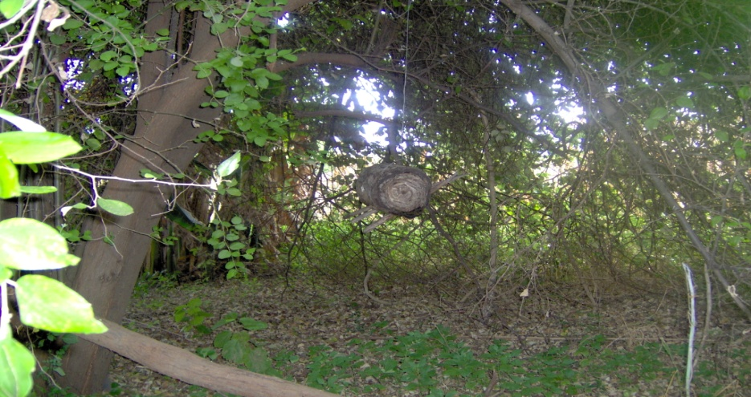
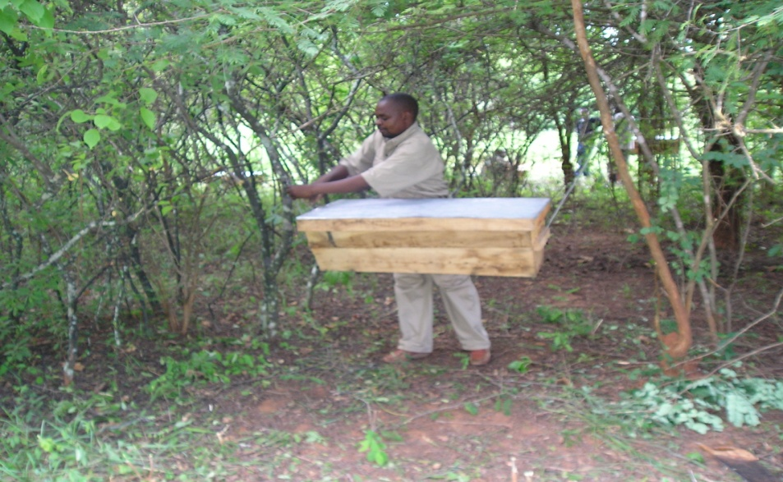
1.0 INTRODUCTION
Beekeeping is an art, science & /or business of managing honey bees in hives.
For the purpose of producing honey, beeswax & other hive & bee products & services for household consumption & /or sale.

Slide 4
INTRODUCTION CONT’D
Rural & forestry based enterprise
Main beekeeping practices are traditional bark & modern frame hives
Has social & economic potential
Supports sustainable forest management
Supports livelihood of rural people

Slide 5
2.0 BEEKEEPING REQUIREMENTS
# | ITEM & DESCRIPTION
1.0 | Production – Small scale
1.1 | Forested Land –
1.2 | Hives:
 | Bark hives, Top bars, Transitional, Langstroth, Dadants with supers, etc
1.3 | Swam boxes
1.4 | Other materials- Stands, nails, suspension wire, etc
Notes:
Swam boxes (2 -5)
Others - Stand materials, nails, suspension wire, etc

Slide 6
2.0 BEEKEEPING REQUIREMENTS CONT’D
# | ITEM & DESCRIPTION
2.0 | Apiary Management – Tools & equipment
2.1 | Smoker
2.2 | Hive tool
2.3 | Bee brush
2.4 | Veil with hood/helmet
2.5 | Overall (Zipped)
2.6 | Pair of gum boots
2.7 | Pair of gloves (Leather)
2.8 | Plastic Buckets (20 Lt)

Slide 7
2.0 BEEKEEPING REQUIREMENTS
CONT’D
# | ITEM & DESCRIPTION
3.0 | Processing & Marketing – Equipment & materials
3.1 | Honey Press
3.2 | Settling tank (50 Lt)
3.3 | Other materials – Jars, calico cloth, labels, etc

Slide 8
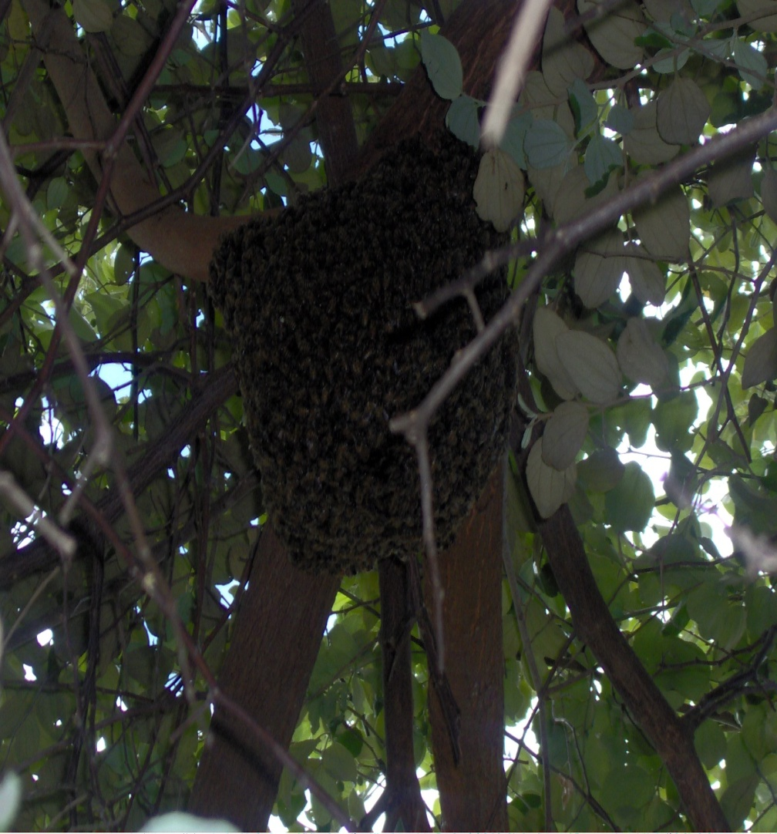
3.0 BEE COLONY
A bee colony (swarm) is a unit of bees comprising three (3) castes or bee types namely queen, worker & drone. These bees play distinct roles.

Slide 9
3.1 Bee castes & roles
CASTE | ROLE
QUEEN | A female bee that lays eggs & mother of all bees in the colony. It has much larger body than the other bees in the colony. A colony has only one queen.
WORKER | Found in thousands [10 to 60,000] in the colony. They do most of the tasks which include feeding & caring for brood & queen, building new combs, foraging for pollen, nectar, water & defending the colony.
DRONE | Male bees found in hundreds [100-400] in a colony. Their main role is to mate with virgin queens. They are found in the colony during breeding season when new queens are expected.

Slide 10
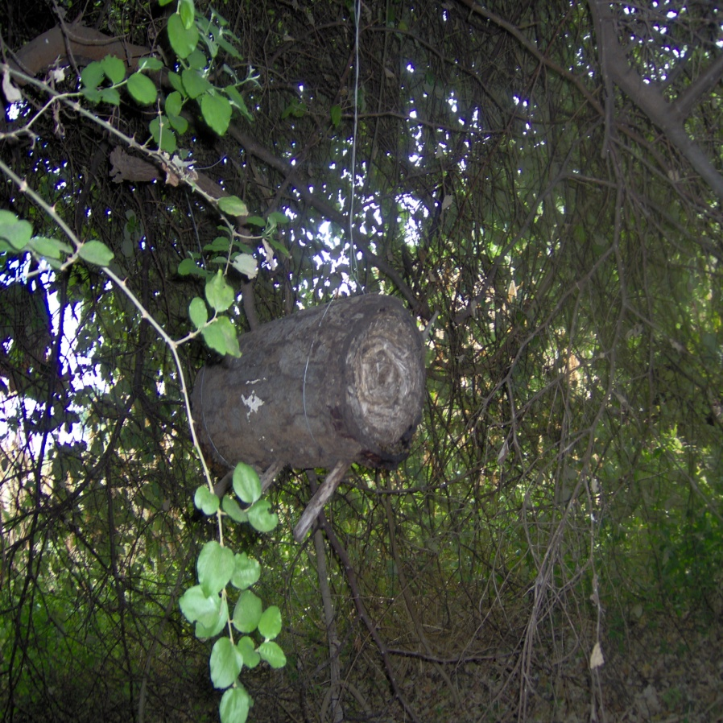
4.0 TYPES OF HIVES
Hives are man made containers meant to accommodate bees. There are of different types & can be made from different materials.
The common hives in Zambia are bark hives made from the bark of trees & usually cylindrical in shape with fixed combs.
Similar hive shapes can also be made using grass, mats, logs, slabs & bamboos.

Slide 11
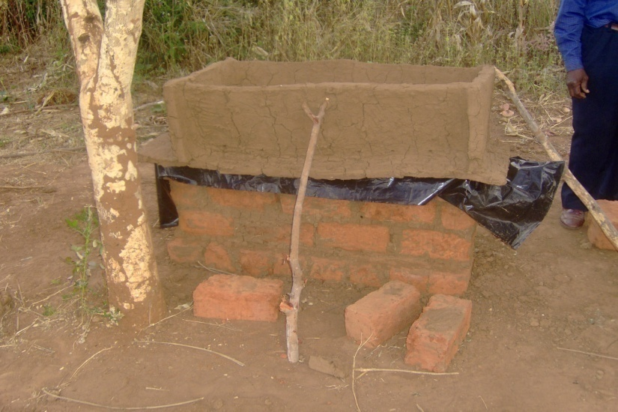
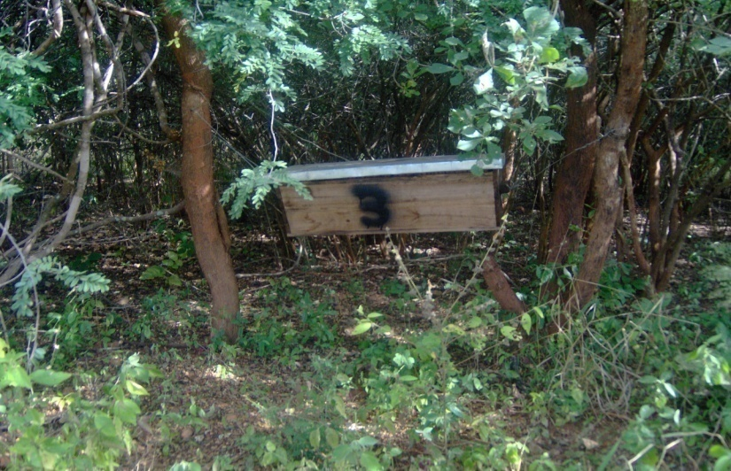
TYPES OF HIVES CONT’D
mud
The other hives are in form of boxes.
These are made mainly from wood but other materials such as bricks, mud, bamboos & grass can also be used.
These contain movable combs either in form of bars [i.e. Kenya top bars] or frames [i.e. Dadants & Langstroth].

Slide 12
4.1 Quality of good hives
Bees will thrive in any container provided it is:-
Water tight
Reasonably drought proof
Safe from pests
Does not get too hot or cold
Large enough to enable the swarm to develop into an efficient working colony of bees

Slide 13
5.0 APIARY ESTABLISHMENT
An apiary is a site where several honey bee hives are kept. These hives can be scattered over an area or concentrated either in a bee yard, bee house or shelter.
The number of hives in an apiary depends on the type of hives and availability of nectar & pollen trees.
Movable comb hives [Top bars & frame hives] can be grouped up to 40.
However, small apiaries are desirable than large ones by being easier to manage & limits the competition of bees for nectar & pollen.

Slide 14
5.1 Apiary site selection.
The following are the main factors to consider when
selecting an apiary site:-
Availability of major bee flora plants
Perennial water supply
Safety from pests & predators
Avoid the exposure of hives to extreme temperatures,
moisture & strong winds
It should not be too close to homes, public places &
roads, preferably 200m away.

Slide 15
5.2 Placement of hives in an apiary
Hives must be protected from direct heat, wind, rain, livestock & game,
pests, thieves & bush fires by carrying out the following measures:-
Place the hives in or under a tree which offers sufficient shade
The hive cover or lid must be covered with iron flat sheet or any other waterproof material
Place the hives in a shelter if the hive covers are not waterproof
Fence the bee yard in areas where there are livestock & game
Suspend hives or use stands to protect the hives from ants & termites
Site your apiary near home for easy management & security
Ensure that your hives are safe from bush fires by carrying out early burning between April & July
Make fire breaks around the apiary in case of bee yards.

Slide 16
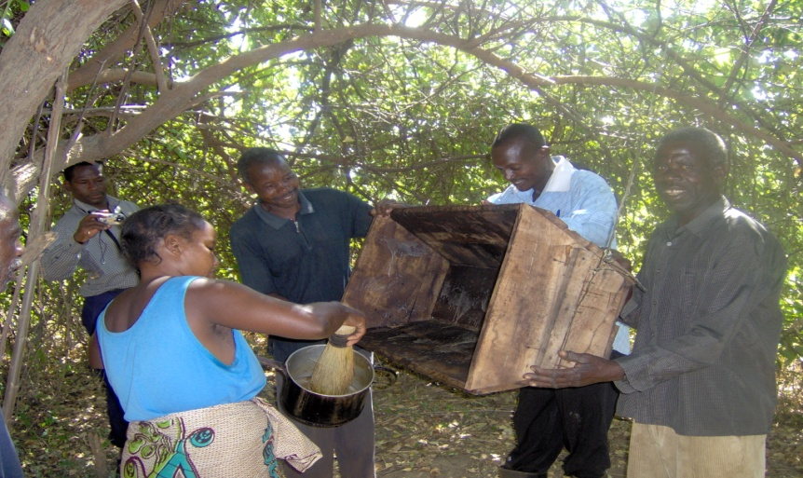
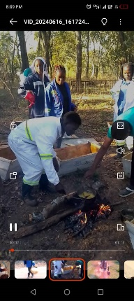
5.3 Baiting & siting
Ensure that your hives are cleaned, baited & sited at the right time.
This should be done just before the swarming period of March & August.

Slide 17
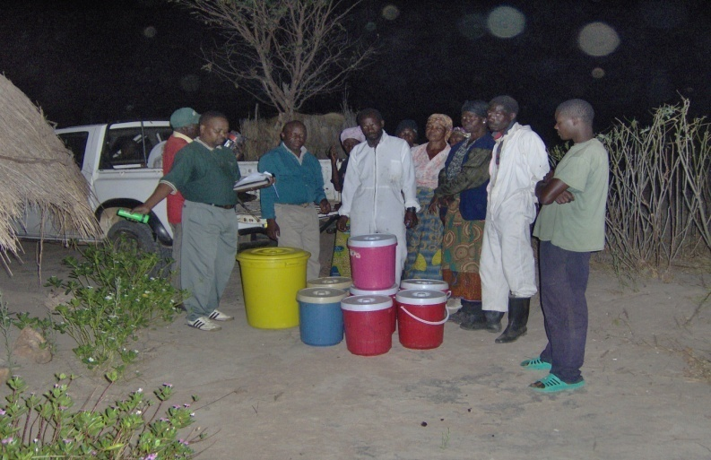
5.4 Record keeping
Record the hives & operations in terms of occupations, absconding, pest attacks, diseases, production, costs & sales.

Slide 18
5.4 Record keeping
Record the hives & operations in terms of occupations, absconding, pest attacks, diseases, production, costs & sales.

Slide 19

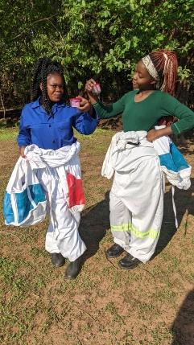
5.4 Record keeping
Record the hives & operations in terms of occupations, absconding, pest attacks, diseases, production, costs & sales.

Slide 20
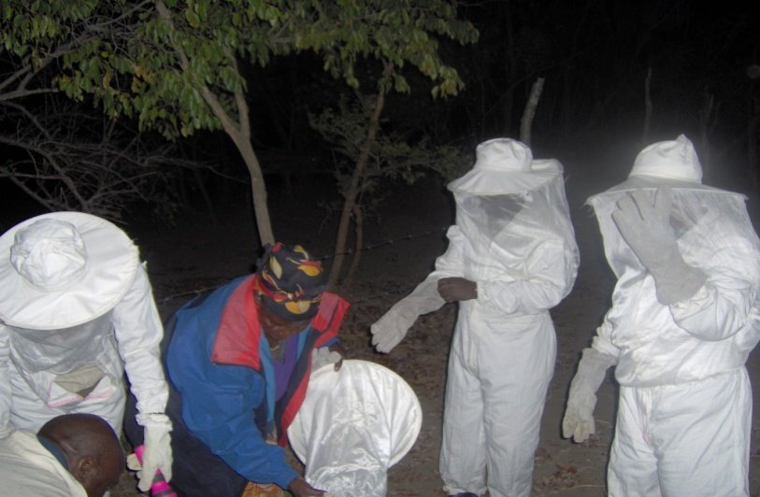
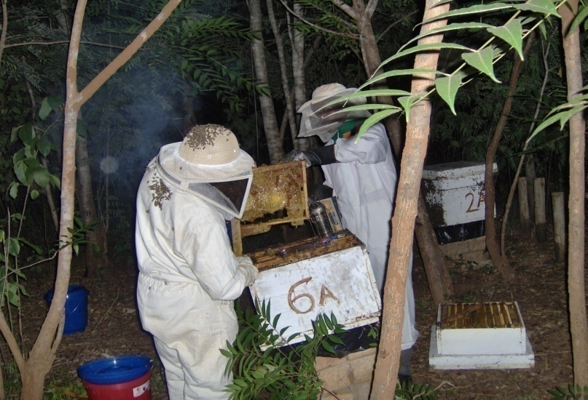
5.5 Honey cropping
Early burning in & around the apiary,
Perimeter clearance
Regular hive inspections
Honey cropping during the honey flows of Oct-Nov & May-June.
To be done when its cool (Early morning or evenings)

Slide 21
6.0 BEE PLANTS/BOTANY
Beekeeping in Zambia is supported by the Miombo woodlands that are dominated by Brachystergias [musamba] & Julbernardias [mutondo] tree pecies.
These provide an excellent source of nectar for the bees.
Brachystergias flower from August to give the October/November honey crop
Julbernardias tree species flower from March to give the May/June honey crop.
Where these do not exist, good yields may still be obtained from other sources such as Acacias, shrubs, herbs, grasses & agricultural crops.

Slide 22
6.1 Need for Forest Conservation
Beekeeping depend on forests for sustenance in terms of habitat, hive materials & forage [nectar and pollen].
Poor managed forest areas have little beekeeping activities & causes flower & crop failure in most cases.
Other attributes include the following:-
  Heavy rainfall when flowers are open
  Excessive dry weather
  Caterpillar defoliation & other plant pest attacks & diseases
  Late fires
  Deforestation
  Pesticide application

Slide 23
7.0 BEEKEEPING PROMOTION APPROACHES
Extension
Demonstrations
Training
Research & Development

Slide 24
7.1 EXTENSION SERVICE PROVIDERS
Government Forestry Dept ZFC, CBU, etc | Policy guidance, regulation, training & extension.
Traders, Packers & Processors | Extension, input supply, processing & marketing
NGOs & Agencies , e.g. Zambia Honey Council (ZHC) Zambia Development Agency (ZDA) Wildlife Conservation Society of Zambia (WCSZ) Kasisi Farmers Training Centre Centre for International Forestry Research (CIFOR) | Coordination & regulation Export promotion Conservation & extension Training Research, extension & policy reform

Slide 25
7.2 Extension methods
Visitations – Targets individuals & households
Meetings - Targets groups, associations, cooperatives, etc
Field days and tours
  Show recommended practices
Shows and exhibitions
  Good for publicity of available products & services
Media & publications
  Reaches out to a large audience

Slide 26
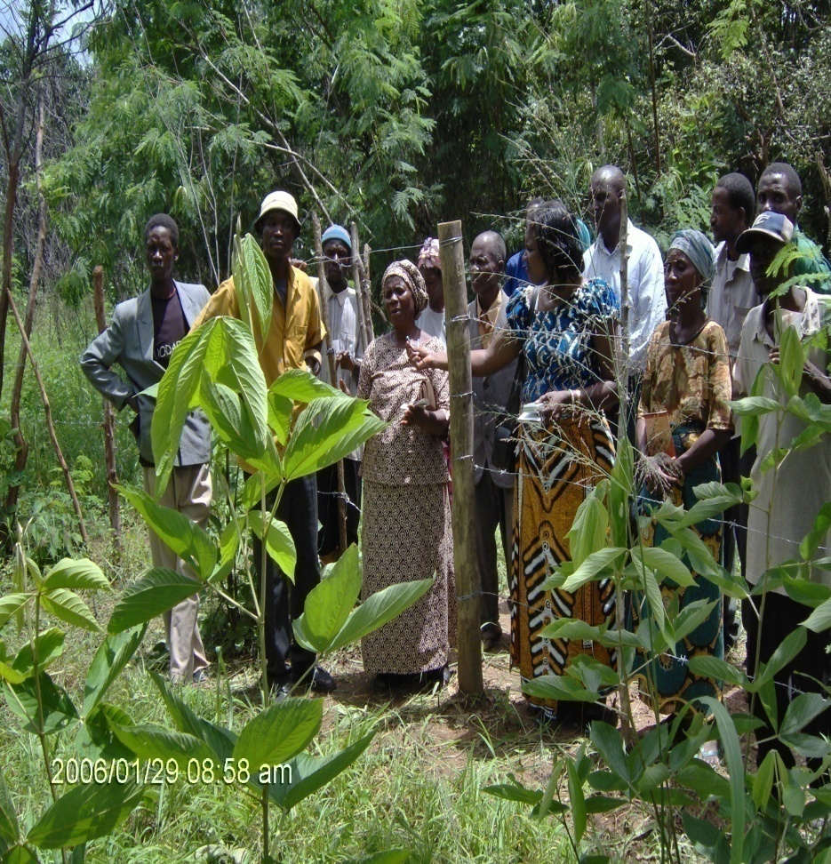
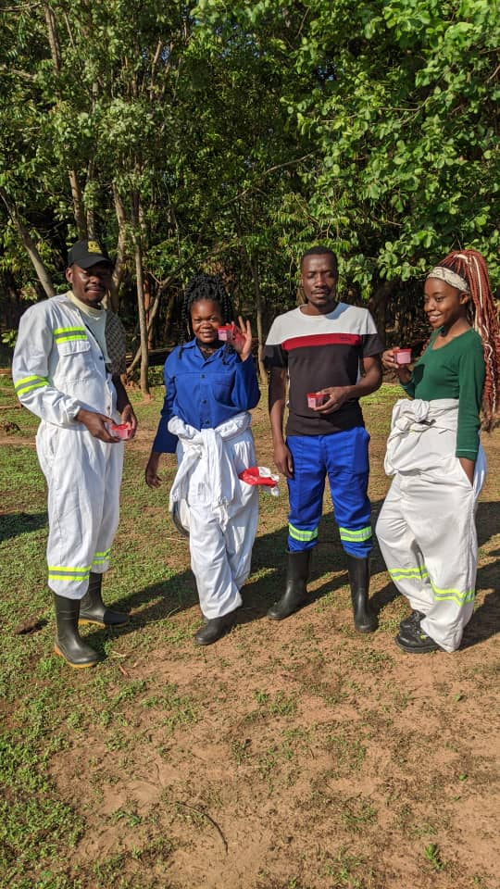
7.4 Field tour of apiaries

Slide 27
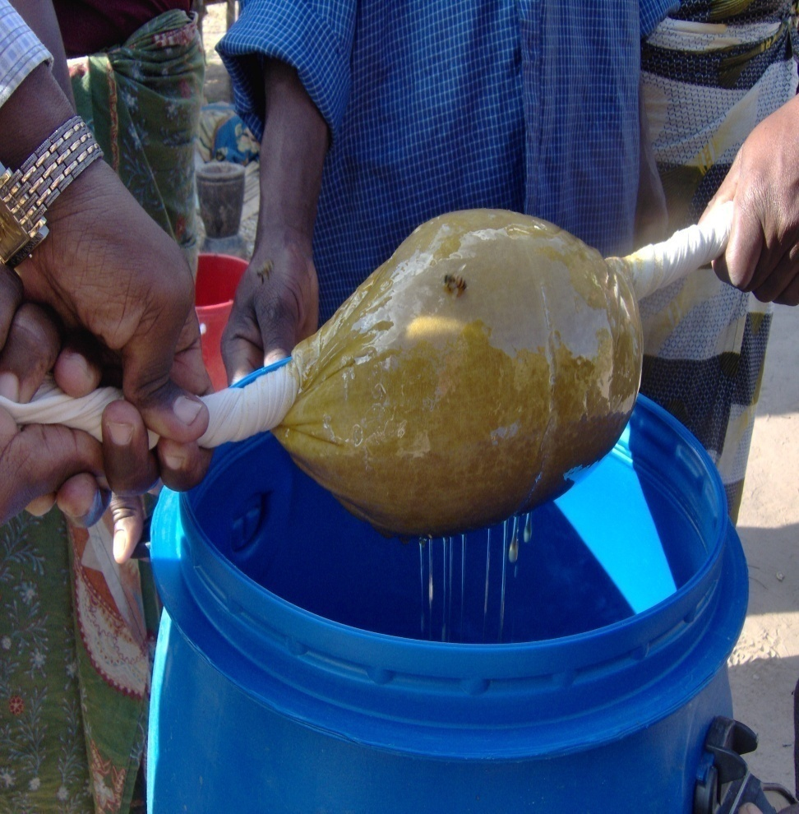
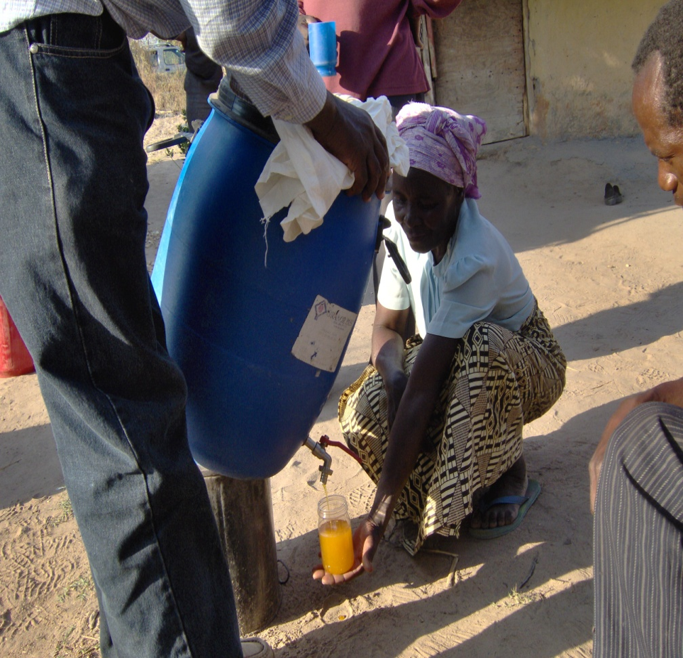
7.5 Honey processing demonstration

Slide 28
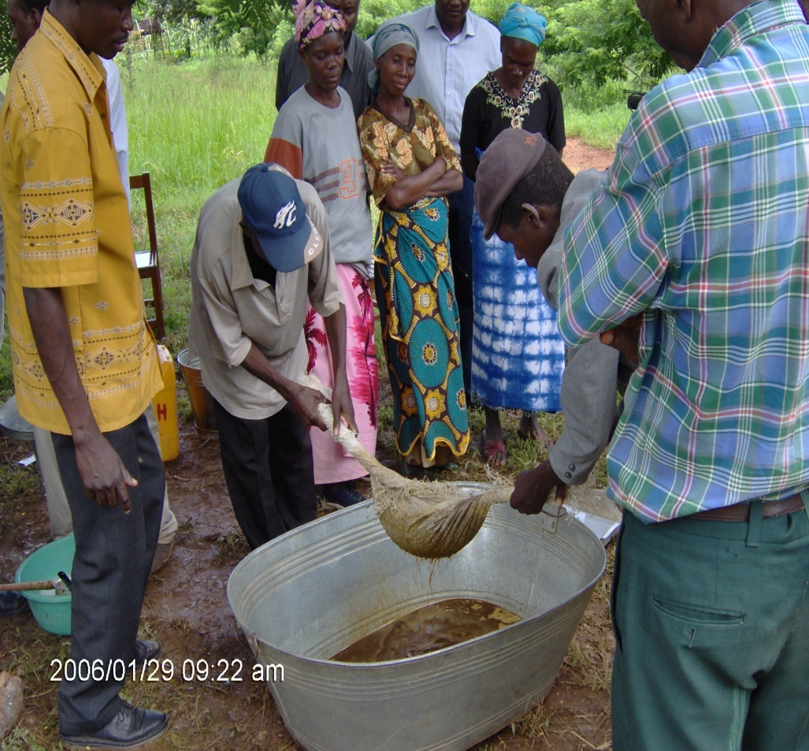
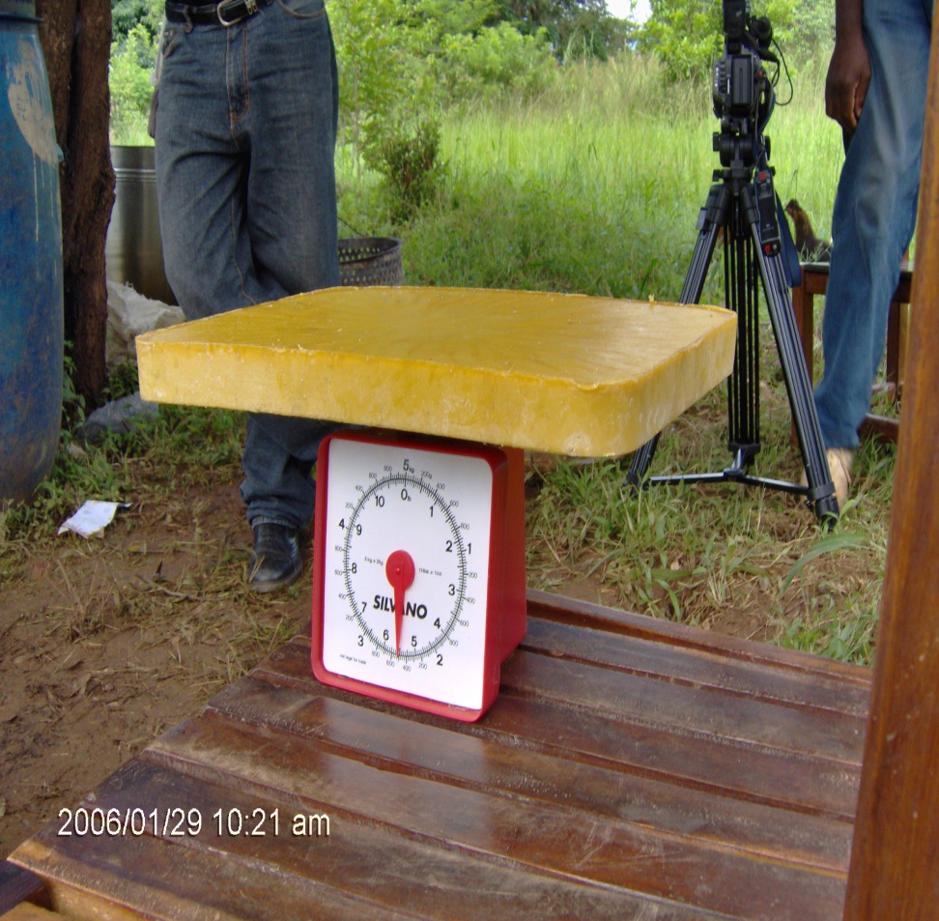
7.6 Beeswax processing demonstration

Slide 29
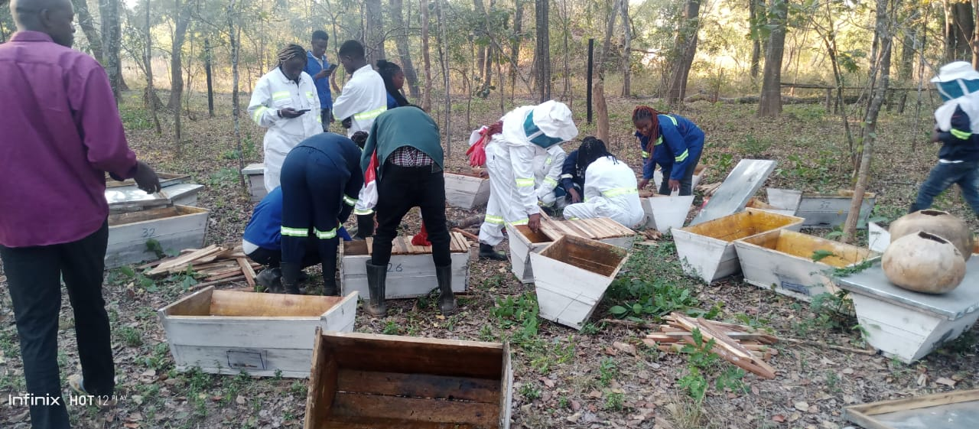
7.8 TRAINING
Training of community beekeepers in various skills

Slide 30
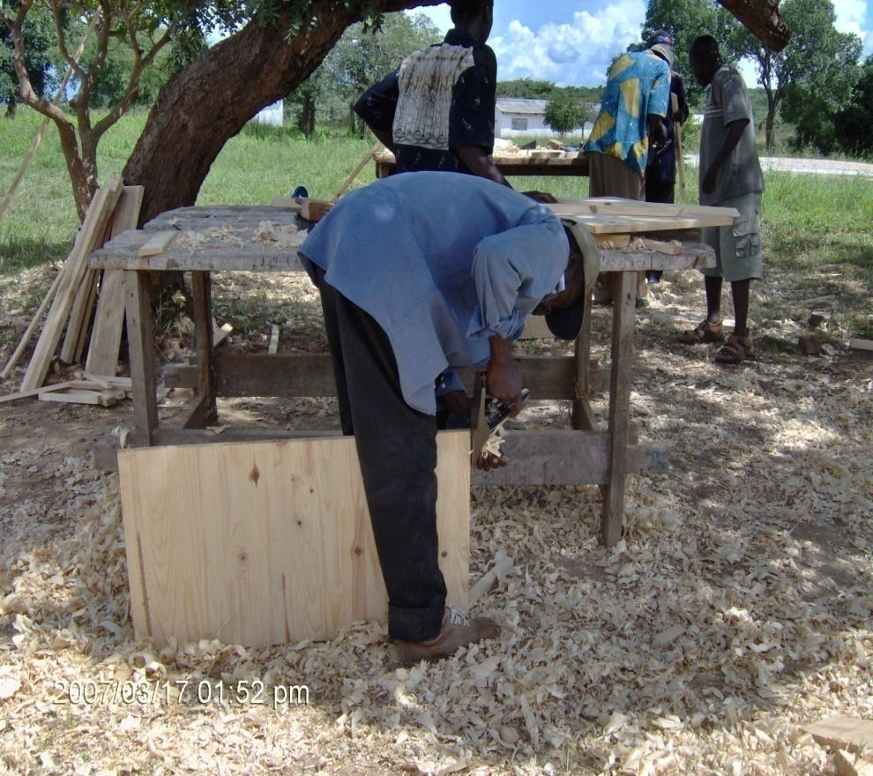
TRAINING CONT’D
Beekeepers trained in modern hive making

Slide 31
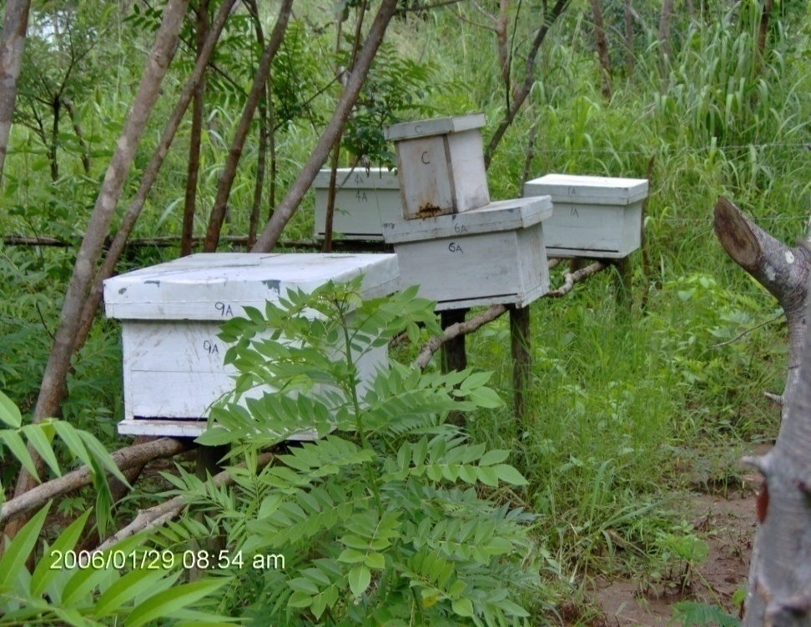
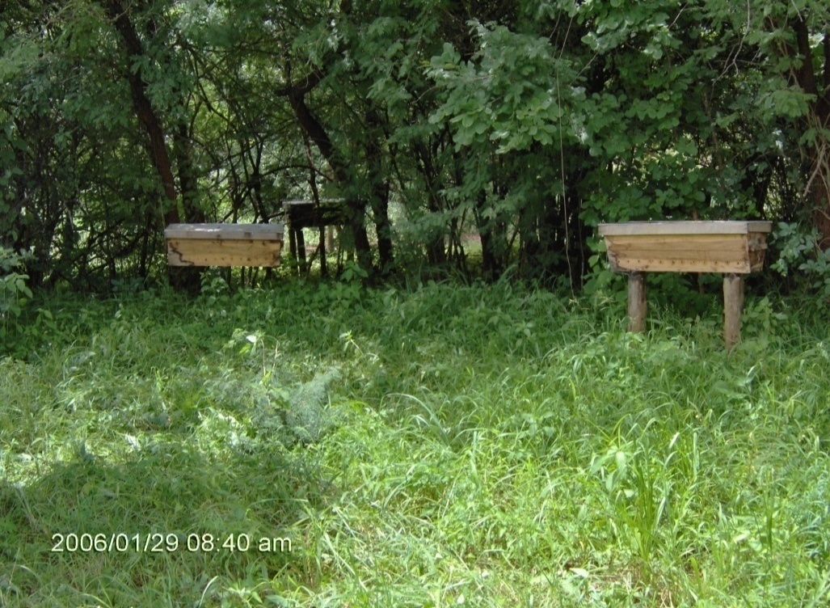
7.9 Research & Development
Performance comparison of Dadant & Kenyan top bar hives

Slide 32
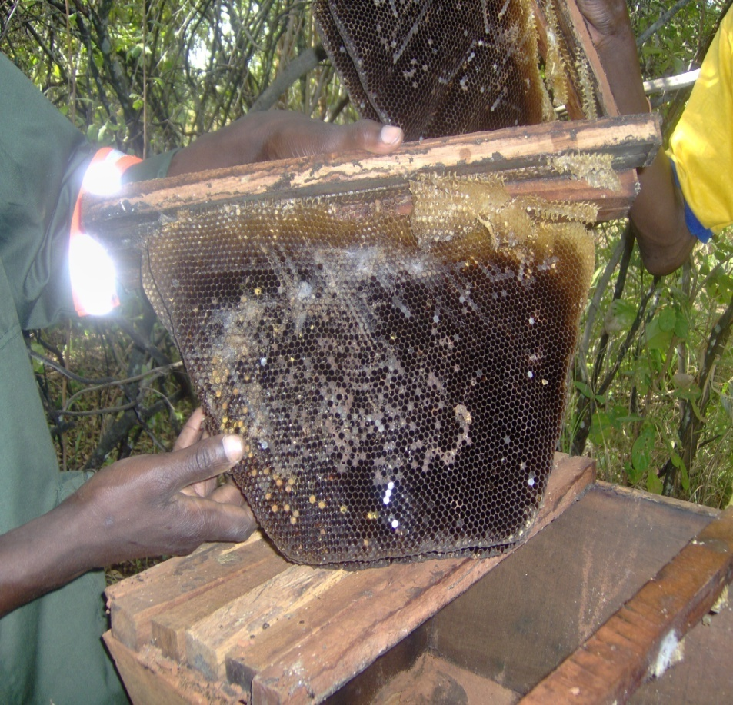
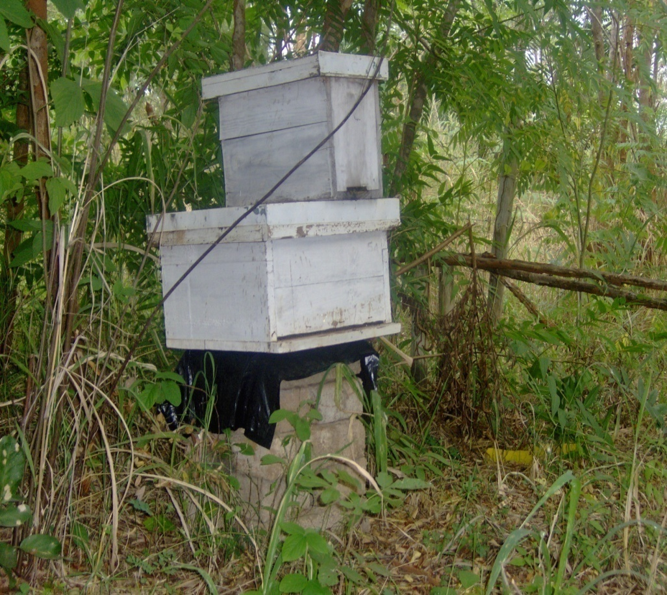
Research & development cont’d
Inspection for bee pests & diseases
Colonies attacked by waxmoth & termites

Slide 33
8.0 ACTIVITIES & CHALLENGES
Extension Approaches | Activities | Challenges
Extension | Exhibits at District, Provincial & National Commercial Agric. Shows Field tours of established apiaries | May require a lot of logistics to organize Remote & few places of interest to visit
Demonstrations | Show results of adopted & best practices e.g. Establishment of demo apiaries Honey & beeswax processing Bee hive baiting & cropping | High cost of introducing new ideas Demo aids may not be adequate

Slide 34
8.0 ACTIVITIES & CHALLENGES
Extension Approaches | Activities | Challenges
Training | Residential courses Mobile training courses | Lack of adequate funds Inadequate transport
Research & Development | Develop innovative beekeeping technologies & practices Monitor, manage & control bee pests & diseases Promote the production of the other bee & hive products & services (i.e. Propolis, Royal jelly, etc) | Inadequate staff skills Lack of tools & equipment

Slide 35
9.0 CONCLUSION
Plan & time activities in line with the beekeeping calendar
of activities.
Understand the people’s - Culture, customs & religious beliefs, calendar of activities, education & experience levels.
Consider cross cutting issues of gender & environment.
Collaborate & network with other institutions in apiculture & related fields
Adopt a combination of methods
Sustainable forest management is important for beekeeping

Slide 36
END OF PRESENTATION
Thank You

